Slide 1
New york city night life clustering
Hernan andres garza uruchurtu

Slide 2
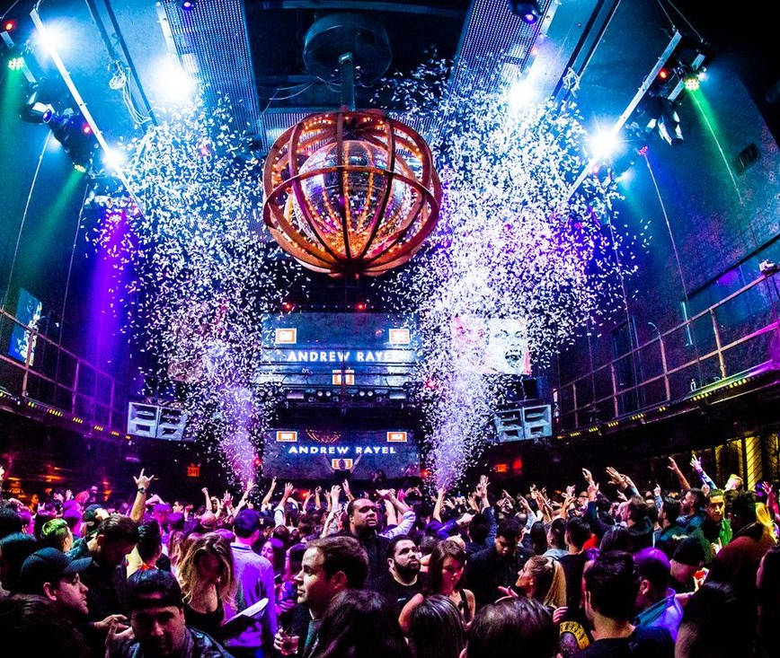
Introduction
New York City has the most known and important night clubs, shows and many more night events in the entire world. This is why this project will be based on the night life of New York City, so that anybody could see the segmentation of the night life of one of the most important cities in the world.

Slide 3
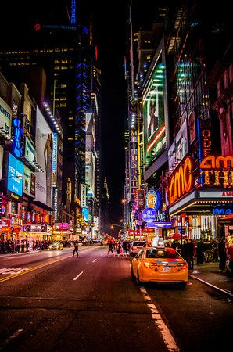
Problem description
New York City received a ninth consecutive annual record of approximately 65.2 million tourists in 2018, counting not just overnight visitors but anyone visiting for the day from over 50 miles away, including commuters. Overall the city welcomed 37.9 million visitors who stayed overnight in 2018, of which 13.6 million were international.
Due to the extended tourism there is a need to segment and classify neighborhoods with its night life, this means that every tourist will have acces to where they whan to experience in an easy way.

Slide 4

Target Audience
This Capstone Project is targeted to tourist who wants to know which neighborhoods have the highest night life, this could affect the choice of the Hotel or Airbnb.

Slide 5
Data collection
Foursquare API
https://developer.foursquare.com/docs
New York City Dataset
https://cocl.us/new_york_dataset

Slide 6
Methodology
Import libraries
Load Data
Transform data into a Data frame
Geopy Latitude and Longitude
Map of NYC Neighborhoods
Clustering

Slide 7
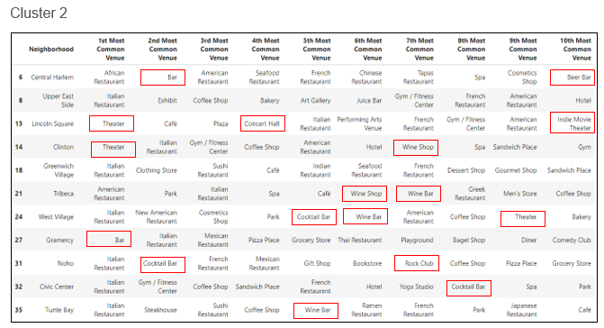
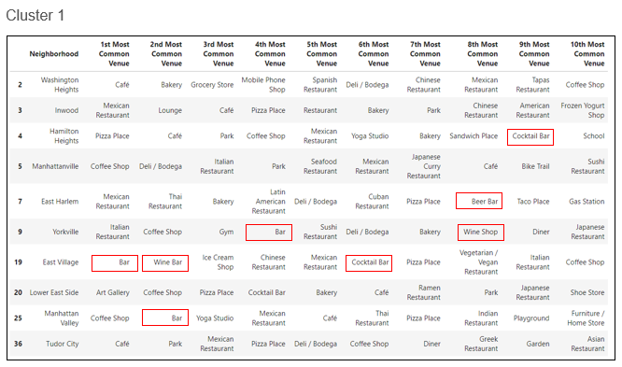
Results

Slide 8
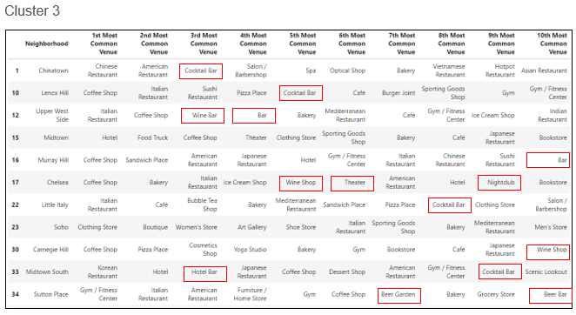
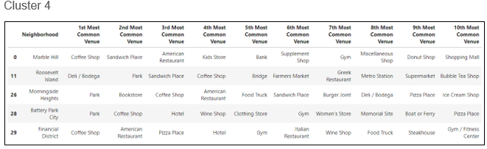
Results

Slide 9
Conlcusions
By making this analysis it is concluded that the Neighborhood with the highest nightlife is East Village followed up by West Village then Upper West Side, then Gramercy and then Nojo. This are the top 5 neighborhoods for nightlife in New York. The cluster with the lowest nightlife is Cluster 4 which will indacate that nightlife tourist will tend to avoide those neighborhoods.
This analysis could be duplicated for any other type of venues such as hotels, restaurants, etc. In this case was made for nightlife such as clubs, bars, Concerthalls etc. to help tourist with their neighborhood selection.

